Slide 1
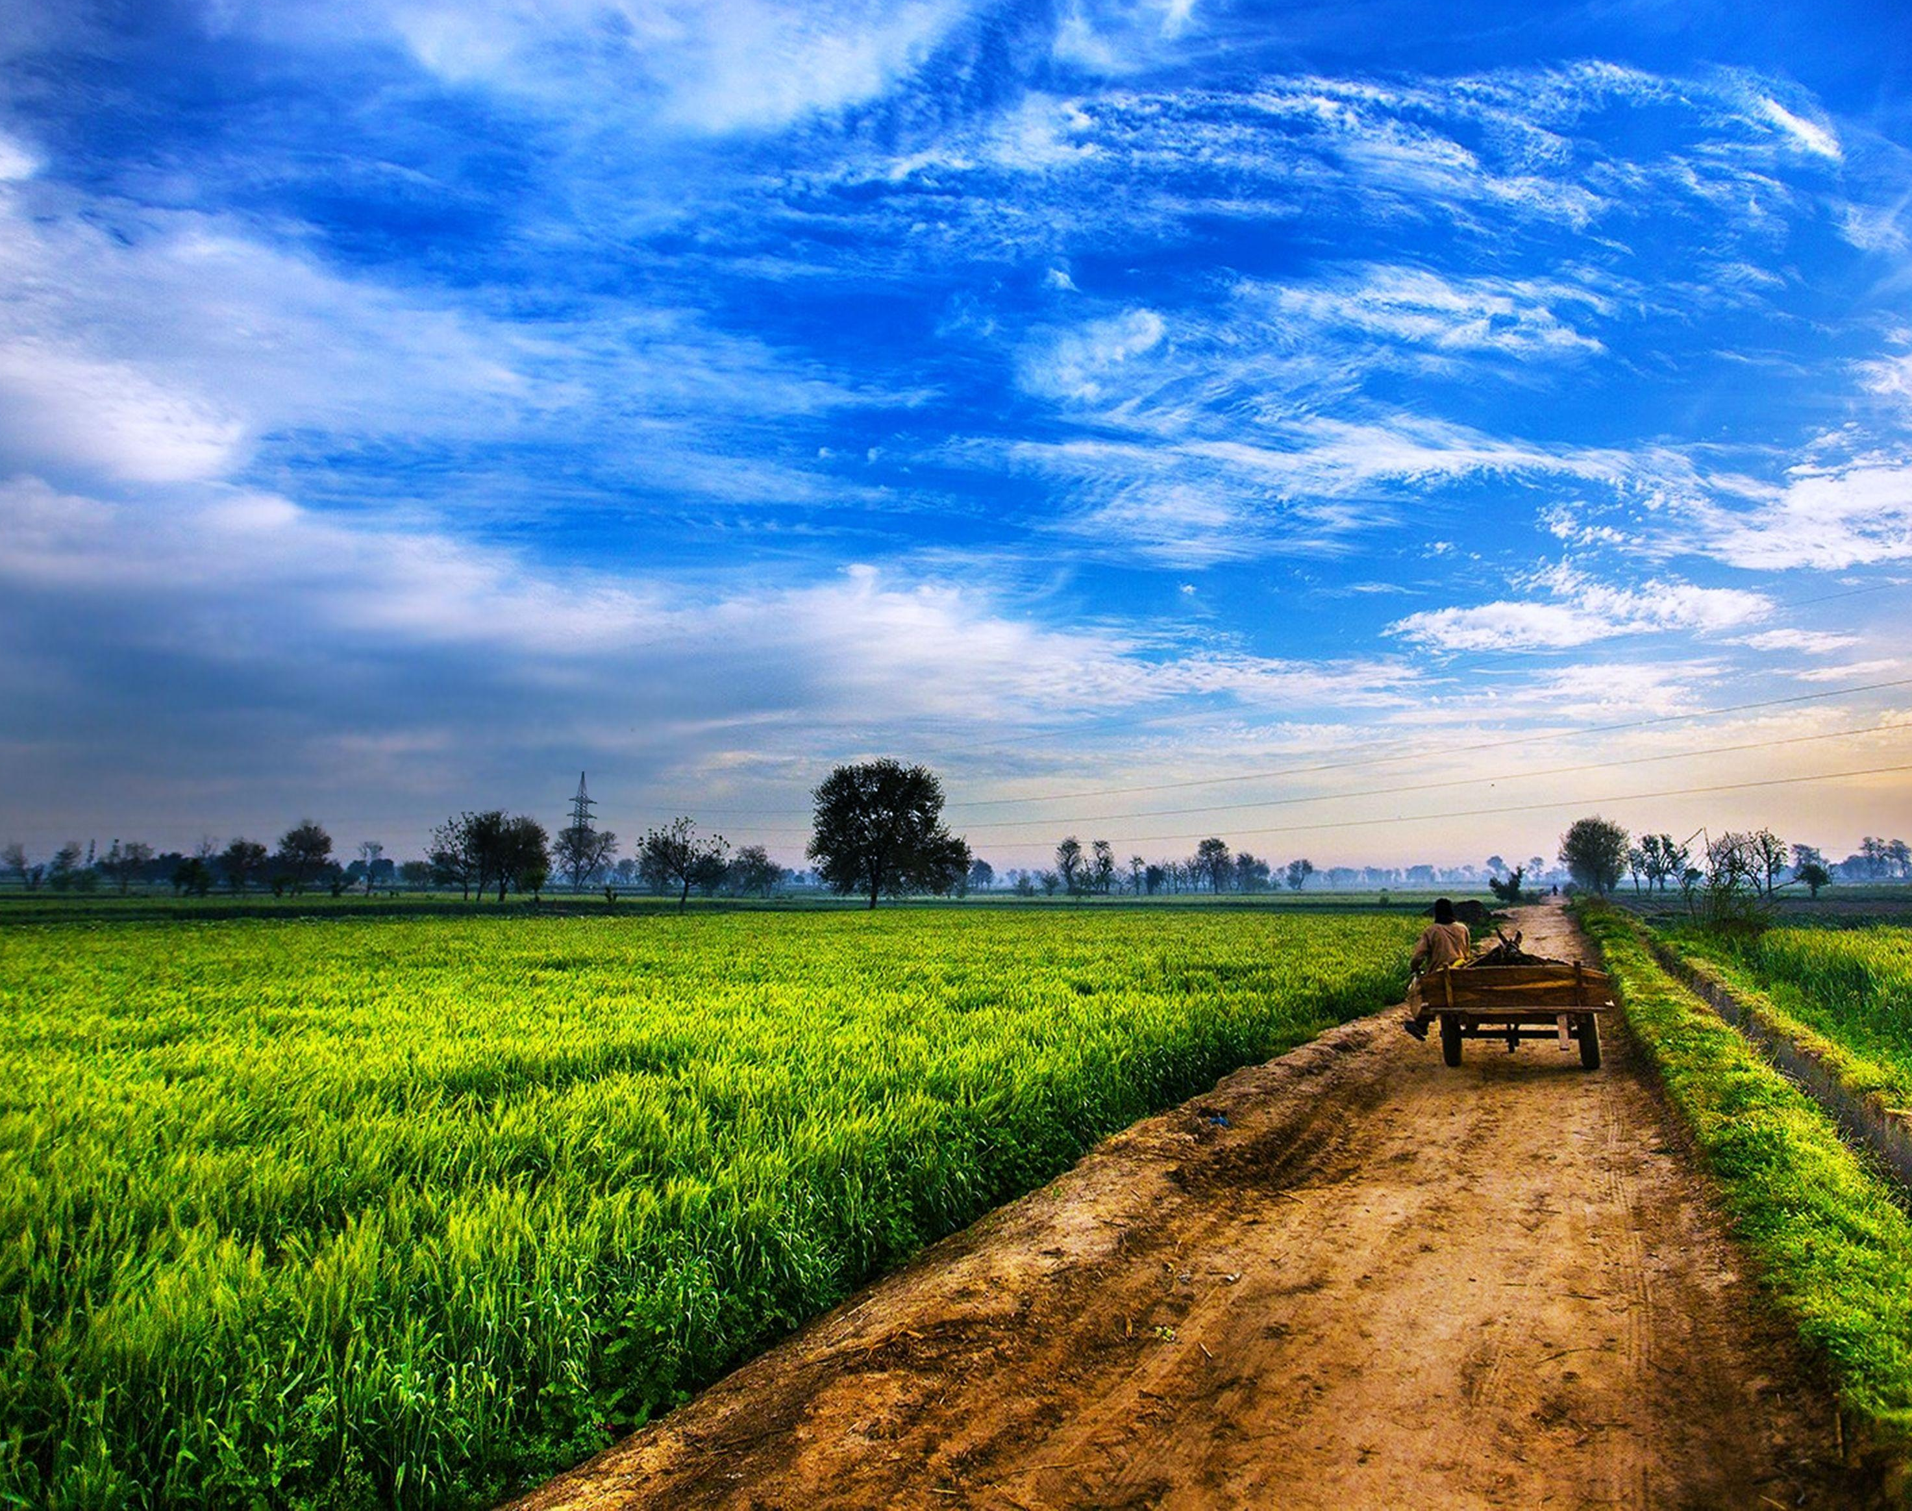
Methane Emissions Status for Manure Management across USA
Environmental Data Analytics | Spring 2021
Kendra Sultzer | Nadia Swit

Slide 2

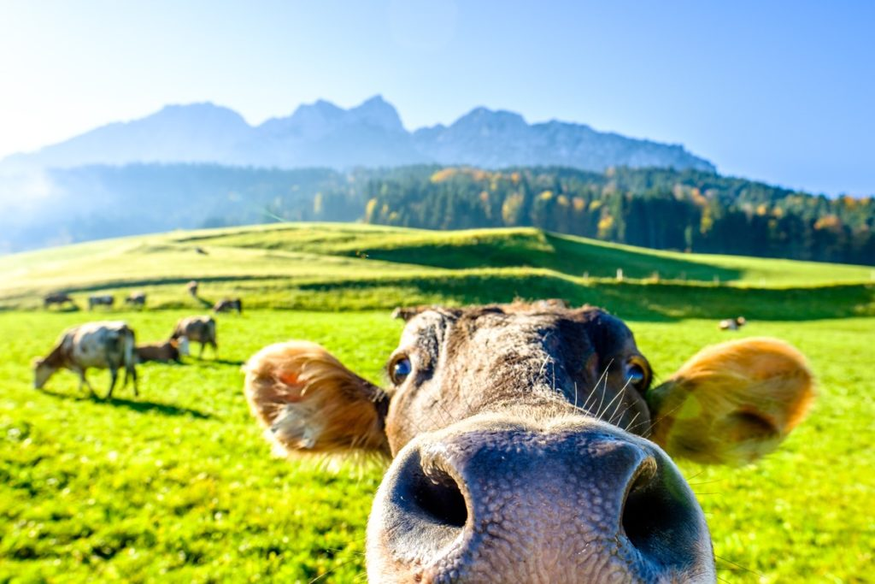
Metadata
Manure management across USA
13 Animal Categories (dairy cows, chickens, turkeys, etc.)
Green house gas emission data – total emissions and emissions rates for CH4, NO2, CO2

Slide 3
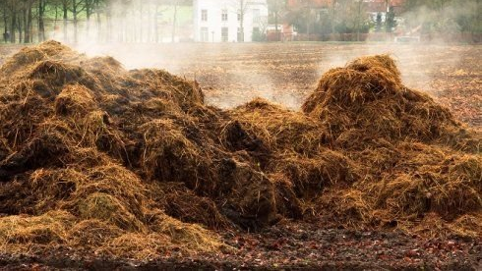
Research Questions
1. Have methane emissions changed over time?

Slide 4
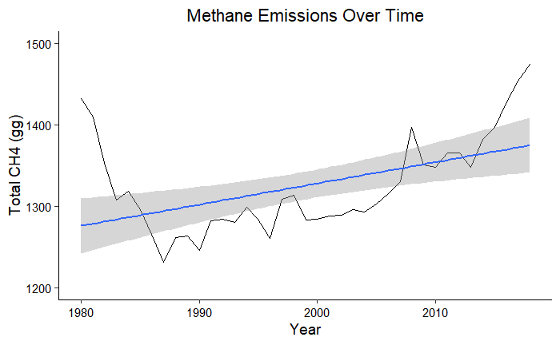

Slide 5
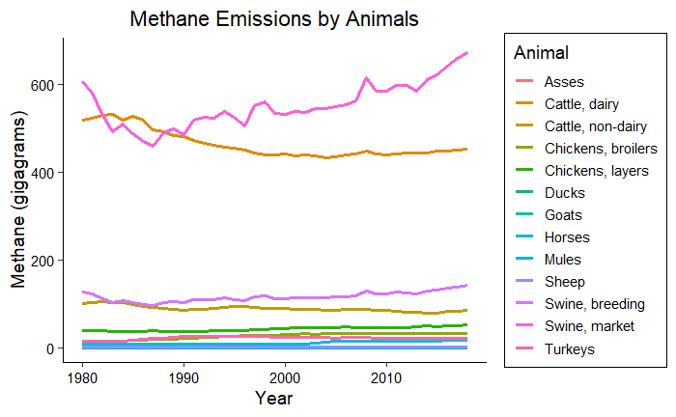

Slide 6
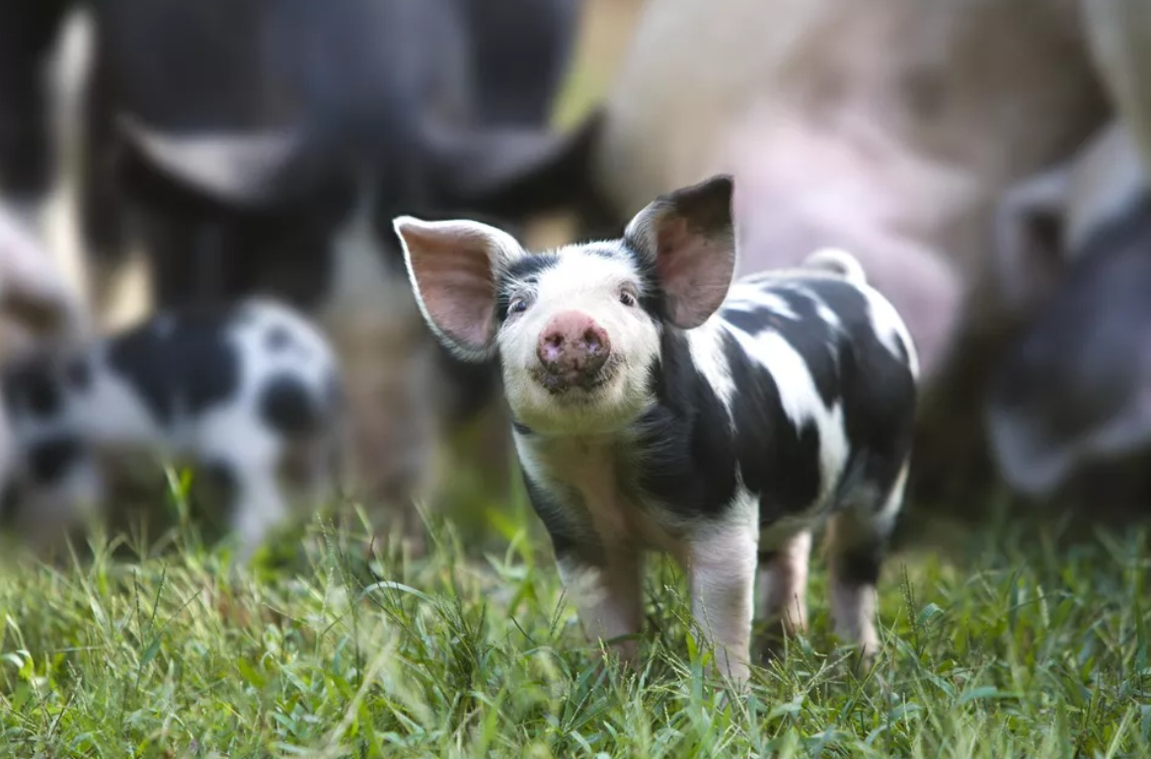
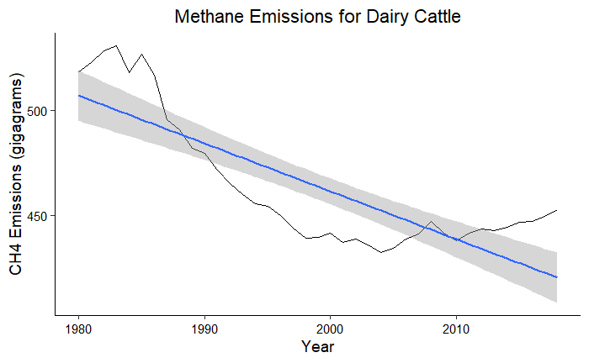
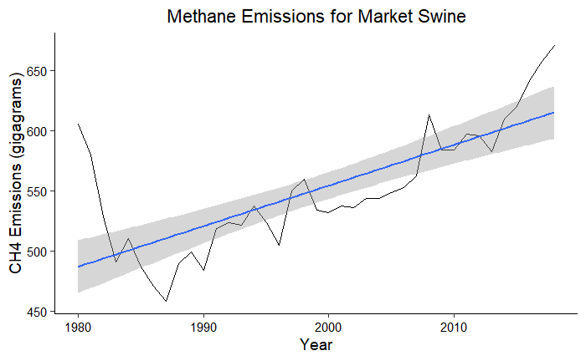
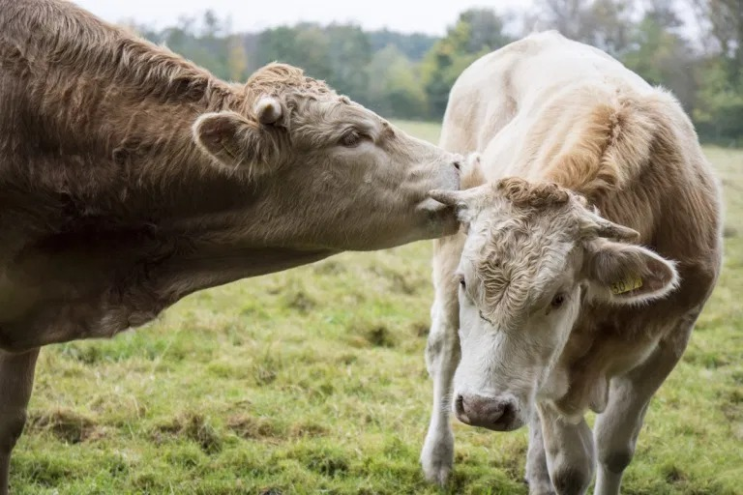

Slide 7
Research Questions
2. Does the average methane emission rate differ between each animal category?

Slide 8
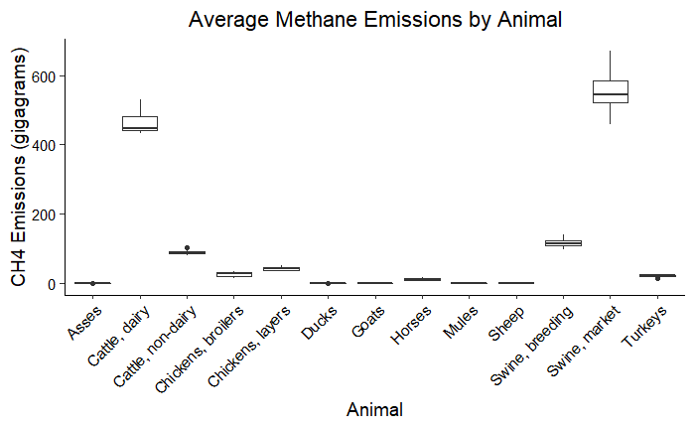



Slide 9
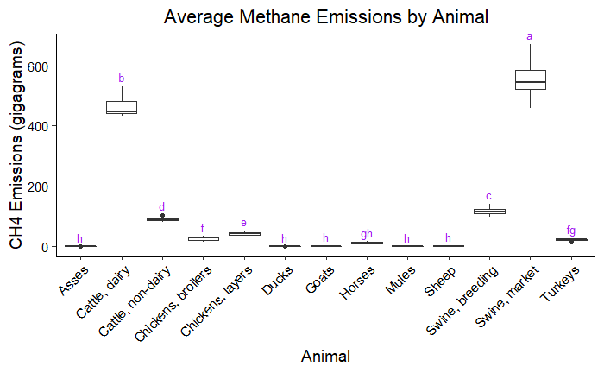





Slide 10
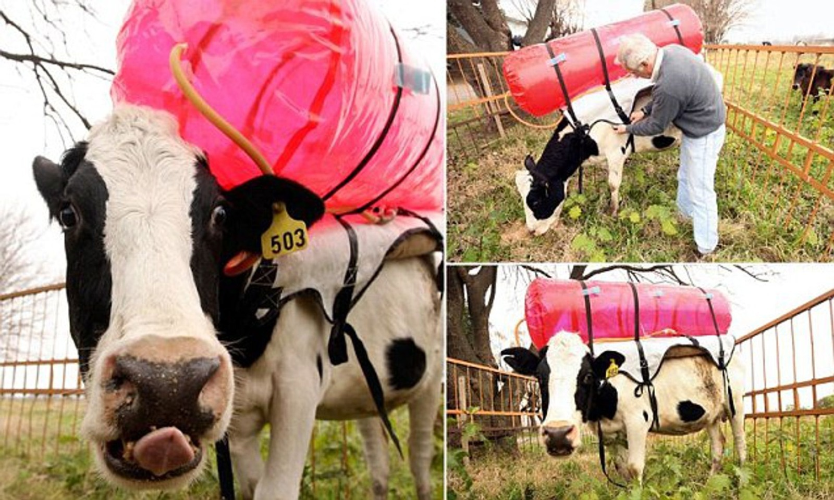

Slide 11
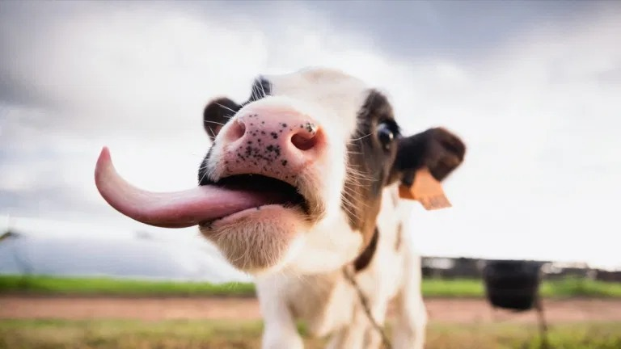
Questions?

Slide 12
Picture Credits
Title page: https://uradafrique.wordpress.com/
Metadata and cow pics: https://bestlifeonline.com/cute-cow-photos/
Poop pic: https://www.wur.nl/en/project/Potentials-of-improved-manure-management-on-resource-use-efficiency-and-emissions-at-a-global-scale.htm
Pig pic: https://www.thespruce.com/how-to-choose-pig-breeds-3016785
Cow backpack: https://www.dailymail.co.uk/sciencetech/article-2606956/Now-THATS-wind-power-Cows-wear-BACKPACKS-capture-emissions-miniature-power-stations.html

